Slide 1
FPD Drinking Metrics
Project Kick-Off
Alexander Bretoi, Sara Iqbal, Kevin Ou, Jamia Russell
Northwestern University
MSDS 475: Project Management
Project Kick-Off
August 4th, 2024

Slide 2
Agenda
9:00 am Welcome & Introductions
Prepare to Introduce Yourself (Name, Role, Fun Fact)
9:15 Project Overview & Scope
Discuss Business Problem
Discuss Project Scope
Key Deliverables and Expected Outcomes
9:30 Project Plan
Timeline and Key Milestones
Dashboard Requirements
AI Tools/Training
9:45 Budget and Resources
Budget Allocation
Financial Reporting/Monitoring
Resource Allocation
9:55 Roles and Responsibilities
Team Structure Overview
Role of Executive Oversight Committee
Project Team Responsibilities
10:10 Project Governance
Communication Protocols and Meeting Schedules
Reporting Lines
10:20 Action Items/What’s Next
Schedule Upcoming Meetings/Milestones
Review of Immediate Tasks
10:30 Questions and Answers (Q&A)
Open for Questions
Final Remarks

Slide 3
Executive Oversight Committee (EOC)
Barbara Coffee (CEO)
Paul Reporting (CFO/Project Sponsor)
Frank Modruson (CIO)
Angela Daniels (VP of Logistics)
Vivica Frederickson (Investor)
Project Management Office (PMO)
Jamia Russell (Project Manager/Presentation Moderator)
Marketing Team
Steve James (VP - Marketing)
Finance Team
IT Team
Jamie Wolf (IT Manager)
Analyst Team
ERP Team
Master Data Team
Audience/Attendees

Slide 4
Management seeks assistance to improve business performance due to issues like:
User dissatisfaction with shipment times
Order fulfillment inconsistencies
Risk of losing major retail clients like Target, Costco, and Walmart, which could substantially decrease FPD's $350 million annual revenue
With a $250,000 project budget, the goal is to implement effective strategies and AI-powered tools to create a metrics dashboard to increase customer satisfaction, standardize operations, and optimize company performance through:
Product line sales analysis
Package performance analysis
Customer/Client segmentation analysis
Order delivery performance tracking
Distribution center performance assessment
Project Overview

Slide 5
The primary objective of the FPD Drinking Metrics (FPD DM) project is to develop and deploy a comprehensive information/metrics dashboard within an allotted six-month timeline and a $250,000 budget.
Project Objective

Slide 6
Project Plan
Activity/Phase | Deliverables
1.1 Define Requirements | High–Level Technical Requirements (Including Functional and Non–Functional), Define Analytics Calculations, Data Modeling, and AI Modeling Requirements
1.2 Design Dashboard | Determine Dashboard Elements (Including Dashboard Design Layout, KPIs, Forecasts, etc.)
1.3 Source/Cleanse Data | Obtain Relevant Data, Validate Data, Clean Data
1.4 Develop Analytics Model | Create Analytics Models (Analytics Calculations, Data Modeling, and AI Modeling Creation), Validate Models
1.5 Construct/Modify Dashboard | Design and Construct Dashboard Presentation Layout, Associate Data, Build Dashboard, and Configure Security
1.6 Testing | Establish UAT Performance Parameters, Validate Dashboard Performance
1.7 User Training | Create Training Documentation, Conduct Training Sessions
1.8 Deploy Dashboard | Deploy to UAT, Deploy to Production
1.9 Project Management | Create Project Plan and Scope Statement, Conduct Daily Scrum Meetings and Weekly Team Meetings, Create Project Status, Milestones & Deliverables Reports

Slide 7
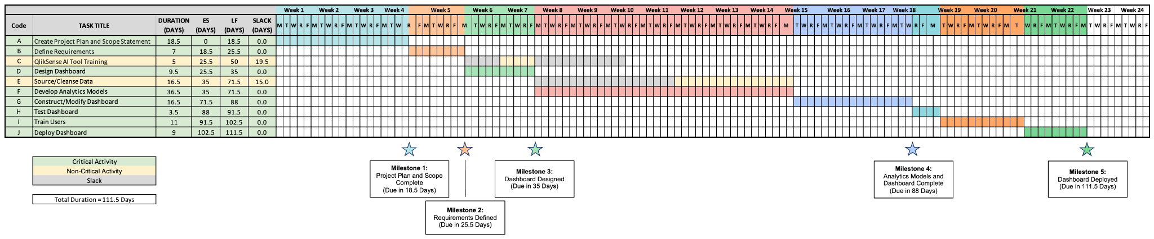
Gantt Chart

Slide 8
Project Governance Structure
EOC RESPONSIBILITIES
Meet 1x monthly with Project Manager
Shape and advise overall direction, allocate resources
Make key decisions, resolve escalated issues, and risk management
EOC
Barbara Coffee
(CEO)
Paul Reporting (CFO/Project Sponsor)
Frank Modruson
(CIO)
Angela Daniels
(VP of Logistics)
Vivica Frederickson (Investor)
Project Management Office (PMO)
PMO RESPONSIBILITIES
Lead execution, enforcing guiding principles
Link between EOC and functional teams
Manage budget, synergy governance and provide reporting to EOC
Jamia Russell, Project Manager
FUNCTIONAL LEADS
IT Development
ERP
Finance
Facilities
Analyst Team
HR & Payroll
FUNCTIONAL TEAM RESPONSIBILITIES
Meet weekly with Project Manager
Identify activities that need to occur and the timeline for each
Perform/delegate day-to-day planning & roadmap tasks
Proactively escalate issues/risks to Project Manager
Provide business/technical expertise
Jamie Wolf - IT Manager
Samuel Lincoln,
ERP Analyst
Fin. Support
Facilities/Building Operations Team
William Jones
Taraji Samson
Michael David
Jamie Levitt
Robert Schafer
Roger Scott
HR Team
IT Team
Nia Short, ERP Analyst
Marketing
Customer Service
Legal - Restructuring
Communications
Master Data
Steve James
(VP - Marketing)
Customer Service Team
Legal Team
Comms Team
Data Transformation/
Engineering Team

Slide 9
Project Communications Plan
What Information | Target Audience | When? | Method of Communication | Provider
Weekly Team Meeting | Project Team Members | Weekly | E-mail; In-Person Meetings | Project Manager
Team Status Reports | Project Manager | Weekly | E-mail | Project Team Members
Project Status Reports & Agendas | Executive Oversight Committee (EOC) Project Team Members | Weekly | E-mail (Hard Copy As Requested) | Project Manager
Monthly Review Meeting | Executive Oversight Committee (EOC) Project Team Members | Monthly | E-mail; In-Person Meetings | Project Manager
Milestones & Deliverables Reports | Executive Oversight Committee (EOC) | Monthly | E-mail (Hard Copy As Requested) | Project Manager
Emergency Escalations | Project Manager | As Needed | Meeting (Zoom); E-mail; Slack | Project Team Members
Change Requests | Executive Oversight Committee (EOC) | As Needed | E-mail (Hard Copy As Requested) | Project Manager

Slide 10
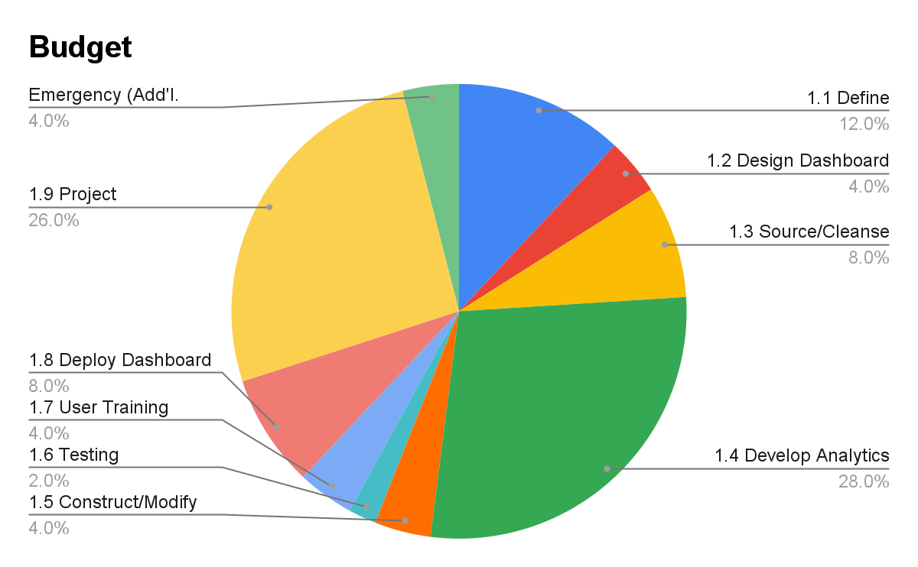
Budget and Financials
 | Budget
1.1 Define Requirements | $30,000.00
1.2 Design Dashboard | $10,000.00
1.3 Source/Cleanse Data | $20,000.00
1.4 Develop Analytics Model | $70,000.00
1.5 Construct/Modify Dashboard | $10,000.00
1.6 Testing | $5,000.00
1.7 User Training | $10,000.00
1.8 Deploy Dashboard | $20,000.00
1.9 Project Management | $65,000.00
Emergency (Add'l. Expenses, Consulting, etc.) | $10,000.00

Slide 11
Resource Allocation
Budget |  | Notes
HR Payroll | $230,000.00
Project Manager | $48,000.00 | 960hrs. @ $50/hr.
IT Manager | $43,200.00 | 960hrs. @ $45/hr.
ERP Application Analyst | $38,200.00 | 960hrs. @ Roughly $40/hr. ($39.79/hr.)
Database Analyst | $38,200.00 | 960hrs. @ Roughly $40/hr. ($39.79/hr.)
Supply Chain Analyst | $33,600.00 | 960hrs. @ $35/hr.
Sales Operations Analyst | $28,800.00 | 960hrs. @ $30/hr.
AI Tools Training | $10,000.00 | Fixed Price via Big Data Training Group
Emergency | $10,000.00 | Excess Emergency Funds In Case of Last Minute Unbudgeted Expenses, Need of Third-Party Consultancy, etc.
Estimated Project Total | $250,000.00

Slide 12
Schedule Upcoming Meetings/Milestones
Review Immediate Tasks
Finalize Project Plan
Confirm Resource Allocation
Establish Feedback Mechanisms
Action Items/What’s Next
Notes:
Finalize Project plan: Confirm project scope, objectives, and deliverables.
Validate the work breakdown structure (WBS) and project timeline
Confirm Resource Allocation: Confirm availability and allocation of resources (e.g., personnel, software, hardware).
Address any immediate resource needs or gaps.
Establish Feedback Mechanisms: Establish a process for team members to provide feedback on the project kickoff and plan.
Schedule a follow-up meeting to address any initial concerns or questions.

Slide 13
Q&A

